Slide 1

Project Title : Seasonal Agriculture Performance Analysis
Name : Chitranjan Vishwakarma
College Name : Sri Ram Kishun P.G College Gokul, Karsada, Varanasi
AICTE STU ID : STU6a6aca966acaf1785383574
Note : Here is Upadated ppt, please review it.

Slide 2

PROBLEM STATEMENT
(Agricultural activities are influenced by seasonal variations in environmental conditions, farming practices, resource availability and market conditions.
As a result, agricultural performance may differ from one season to another. However, raw agricultural data does not clearly explain how agricultural performance changes across seasons or what patterns can be observed in different seasonal conditions.
The problem is to analyze the given agricultural dataset and investigate seasonal differences in agricultural performance by identifying meaningful patterns, trends, relationships and variations within the available data.

Slide 3
Project Description
• This project analyzes a dataset of 4,000 farm records spanning 3 seasons (Kharif, Rabi, Zaid), 8 Indian states and 8 crops, covering environmental conditions, farming inputs, resource usage and economic outcomes.
• The dataset was cleaned (median imputation for missing rainfall, soil moisture and yield values, grouped by season and crop) and explored using Python (Pandas, NumPy, Matplotlib, Seaborn, SciPy) inside a VS Code.
• The analysis compares seasons on yield, cost, revenue, profit, water/fertilizer usage and disease risk; tests whether yield differences across seasons are statistically significant and examines correlations between environmental/input factors and outcomes.
• The goal is to convert raw agricultural data into clear, evidence-based insights and recommendations that can support seasonal agricultural planning.

Slide 4

WHO ARE THE END USERS?
Farmers & agricultural cooperatives — choosing crops and irrigation methods by season
Agricultural policy makers & government departments — evidence-based seasonal planning
Agri-input and agribusiness companies — understanding seasonal demand for fertilizer, seed and irrigation equipment
Financial institutions & crop insurers — assessing seasonal profitability and risk
Agricultural researchers & extension officers — studying seasonal yield and resource patterns

Slide 5

Technology Used
Python 3 — programming language
VS Code — analysis environment
Pandas & NumPy — data cleaning & aggregation
Matplotlib, Seaborn & SciPy — visualization

Slide 6
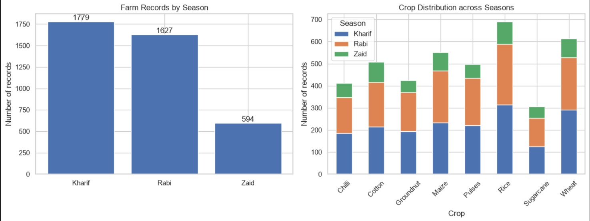
RESULTS
https://chitranjan-7-8-6.github.io/Seasonal-Agriculture-Performance-Analysis/

Slide 7
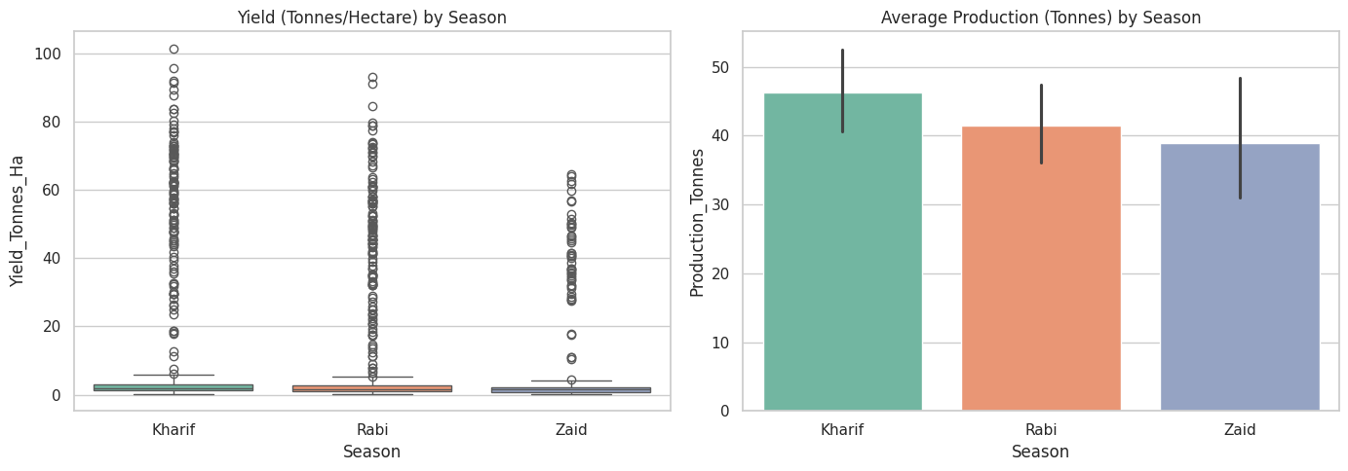
RESULTS
https://chitranjan-7-8-6.github.io/Seasonal-Agriculture-Performance-Analysis/

Slide 8
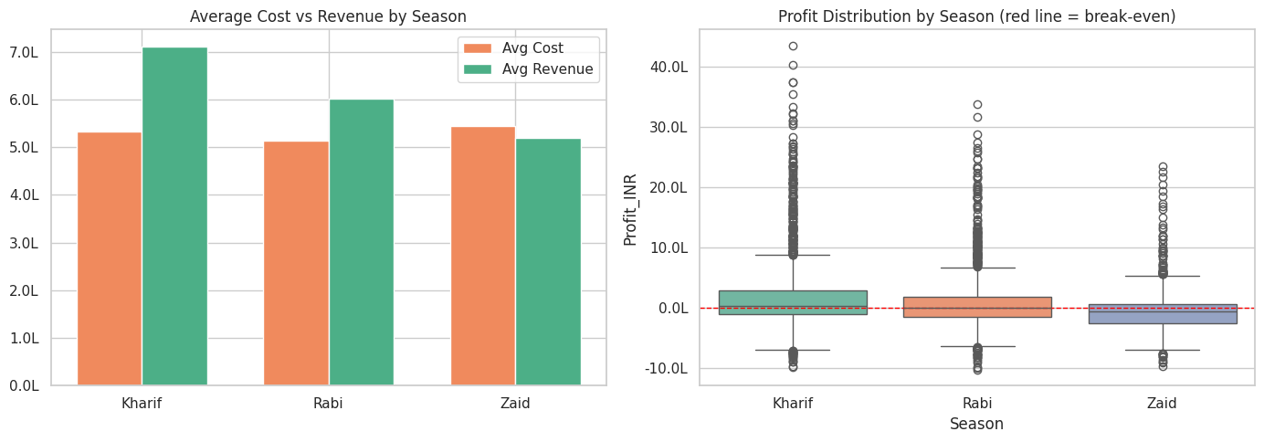
RESULTS
https://chitranjan-7-8-6.github.io/Seasonal-Agriculture-Performance-Analysis/

Slide 9
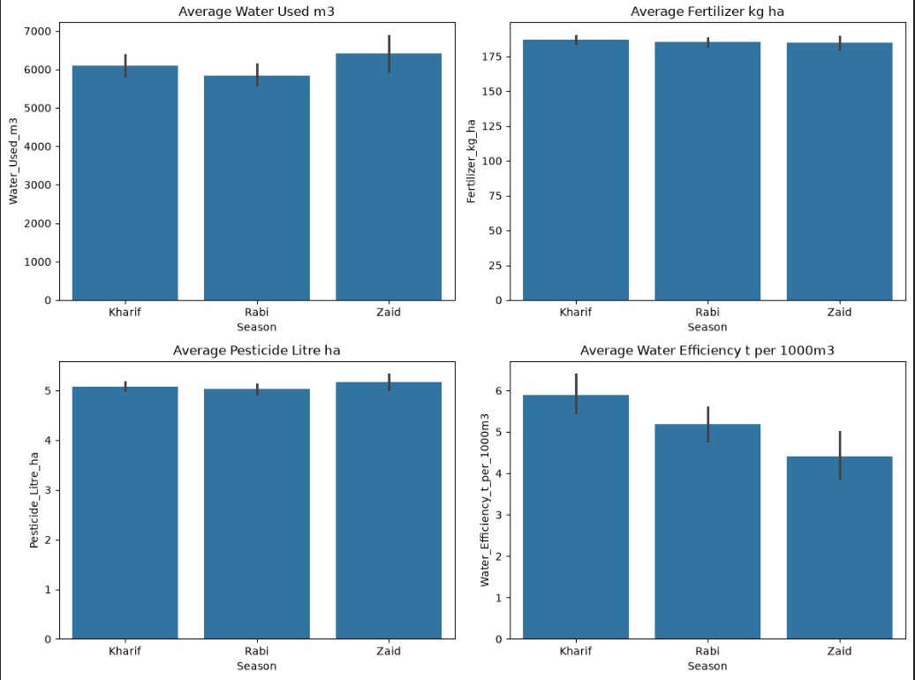
RESULTS
https://chitranjan-7-8-6.github.io/Seasonal-Agriculture-Performance-Analysis/

Slide 10
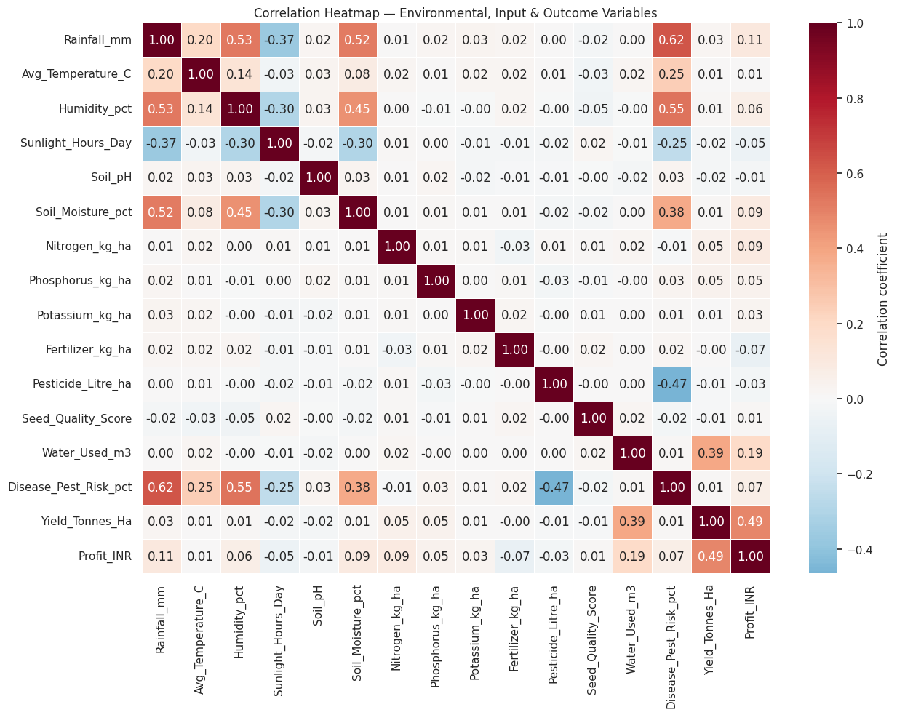
RESULTS
https://chitranjan-7-8-6.github.io/Seasonal-Agriculture-Performance-Analysis/

Slide 11
Future scope
• Build a machine learning model to predict yield and profit from seasonal and input variables
• Integrate live weather and soil-sensor (IoT) data for real-time seasonal recommendations
• Extend the analysis with more granular location data (village/block level) instead of state level
• Add a farmer-facing dashboard for personalized, season-specific crop and irrigation guidance
• Study the root causes of the high loss-making percentage using cost-breakdown data
• Incorporate market-demand forecasting to better time seasonal crop choices

Slide 12
GitHub Link
https://chitranjan-7-8-6.github.io/Seasonal-Agriculture-Performance-Analysis/

Slide 13
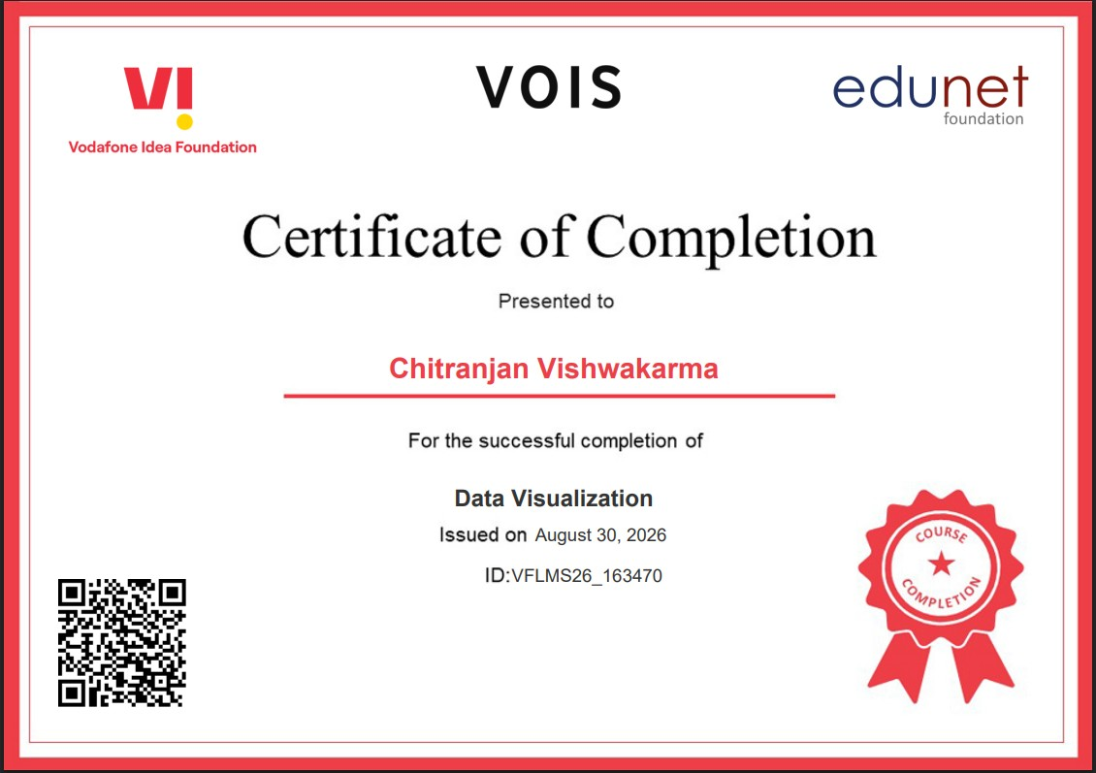
VOIS Course completion certificate - Course name- Data Visualization

Slide 14
Thank you
.
.

